Slide 1
Drug and target gene selection: Dabrafenib and B-RAF
Master Thesis projects idea

Slide 2
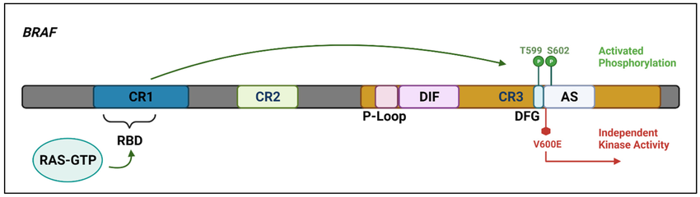
BRAF in cancer
The Genomics of Hairy Cell Leukaemia and Splenic Diffuse Red Pulp Lymphoma, D. Oscier, 2022
BRAF is an oncogene on chromosome 7 that affects the MAPK pathway
Cutaneous Melanoma, Colorectal cancer, Hairy cell leukemia, non-small cell lung carcinoma,…
Active BRAF promotes tumour cell proliferation and survival but also cell invasion, metastasis, and evasion of the immune response
BRAF domains: Ras binding domain (RBD), Cysteine-rich domain (CRD), kinase domain (loop)
CR1 domain binds to activated RAS, CR2 binds to 14-3-3, CR3 is the kinase domain regulated through phospohorylation composed of P-loop that binds ATP and the activation segment (DFG)

Slide 3
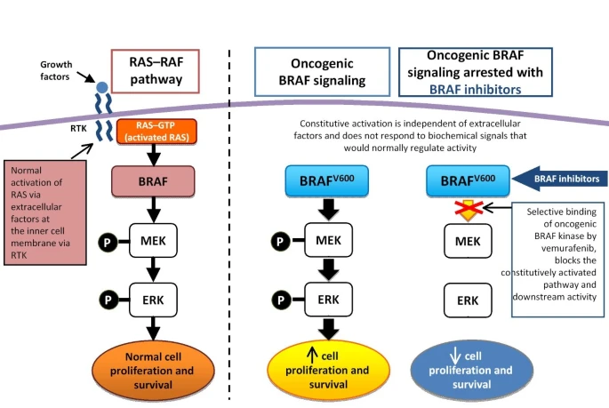
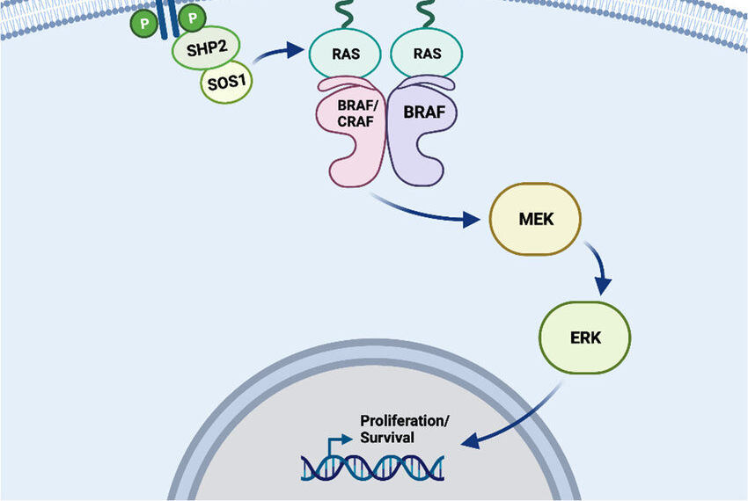
BRAF

Slide 4
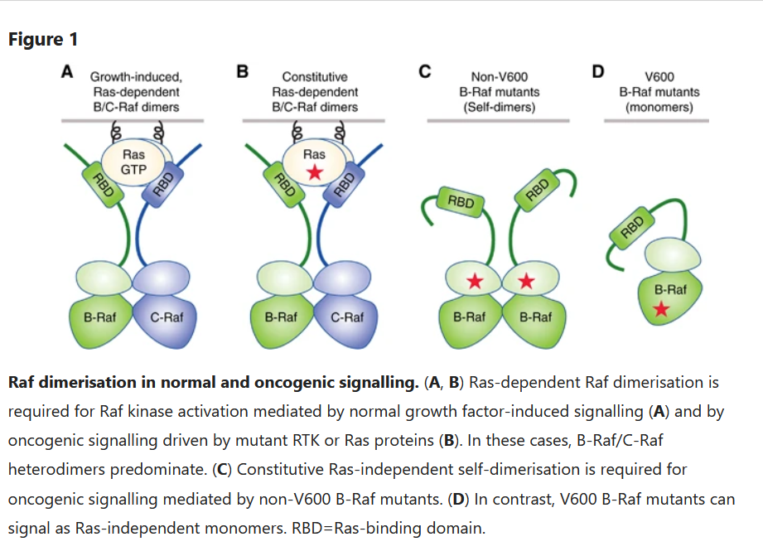
BRAF resistance to dabrafenib
Dabrafenib inhibits the ERK signaling only for tumors with BRAF V600E mutation
Genetic alterations that cause BRAF V600E to dimerize in a RAS-independent manner prevent pathway inhibition by dabrafenib
Other resistance mechanism include: BRAF fusions, other non-V600E mutations
acquired resistance to BRAF inhibitors (BRAFi) appeared within 4–6 months in individuals who were initially responsive

Slide 5
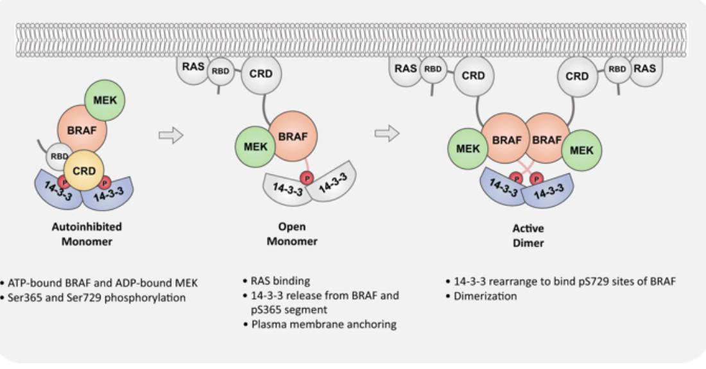
Autoinhibition: The “Cradle” Model
14-3-3 protein dimer attaches BRAF’s phophorilated Serine at positions 365 and 729
Kinase domain is locked and inactive => No dimerization

Slide 6
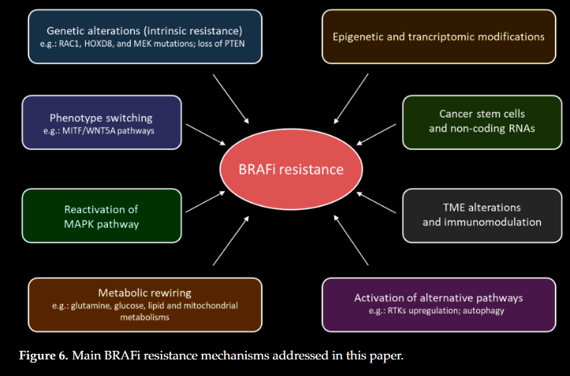
BRAF resistance to dabrafenib

Slide 7
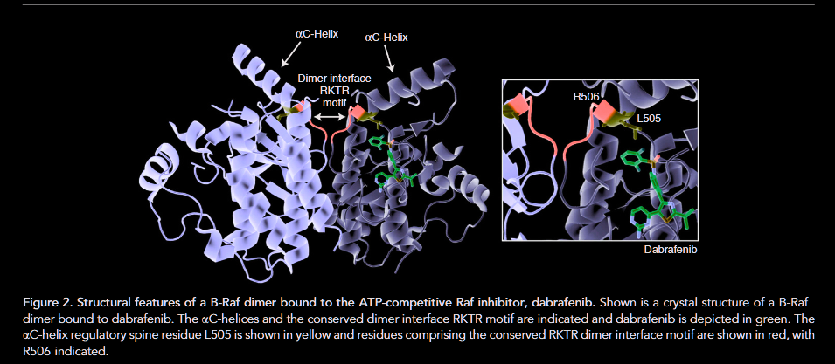
BRAF resistance to dabrafenib

Slide 8
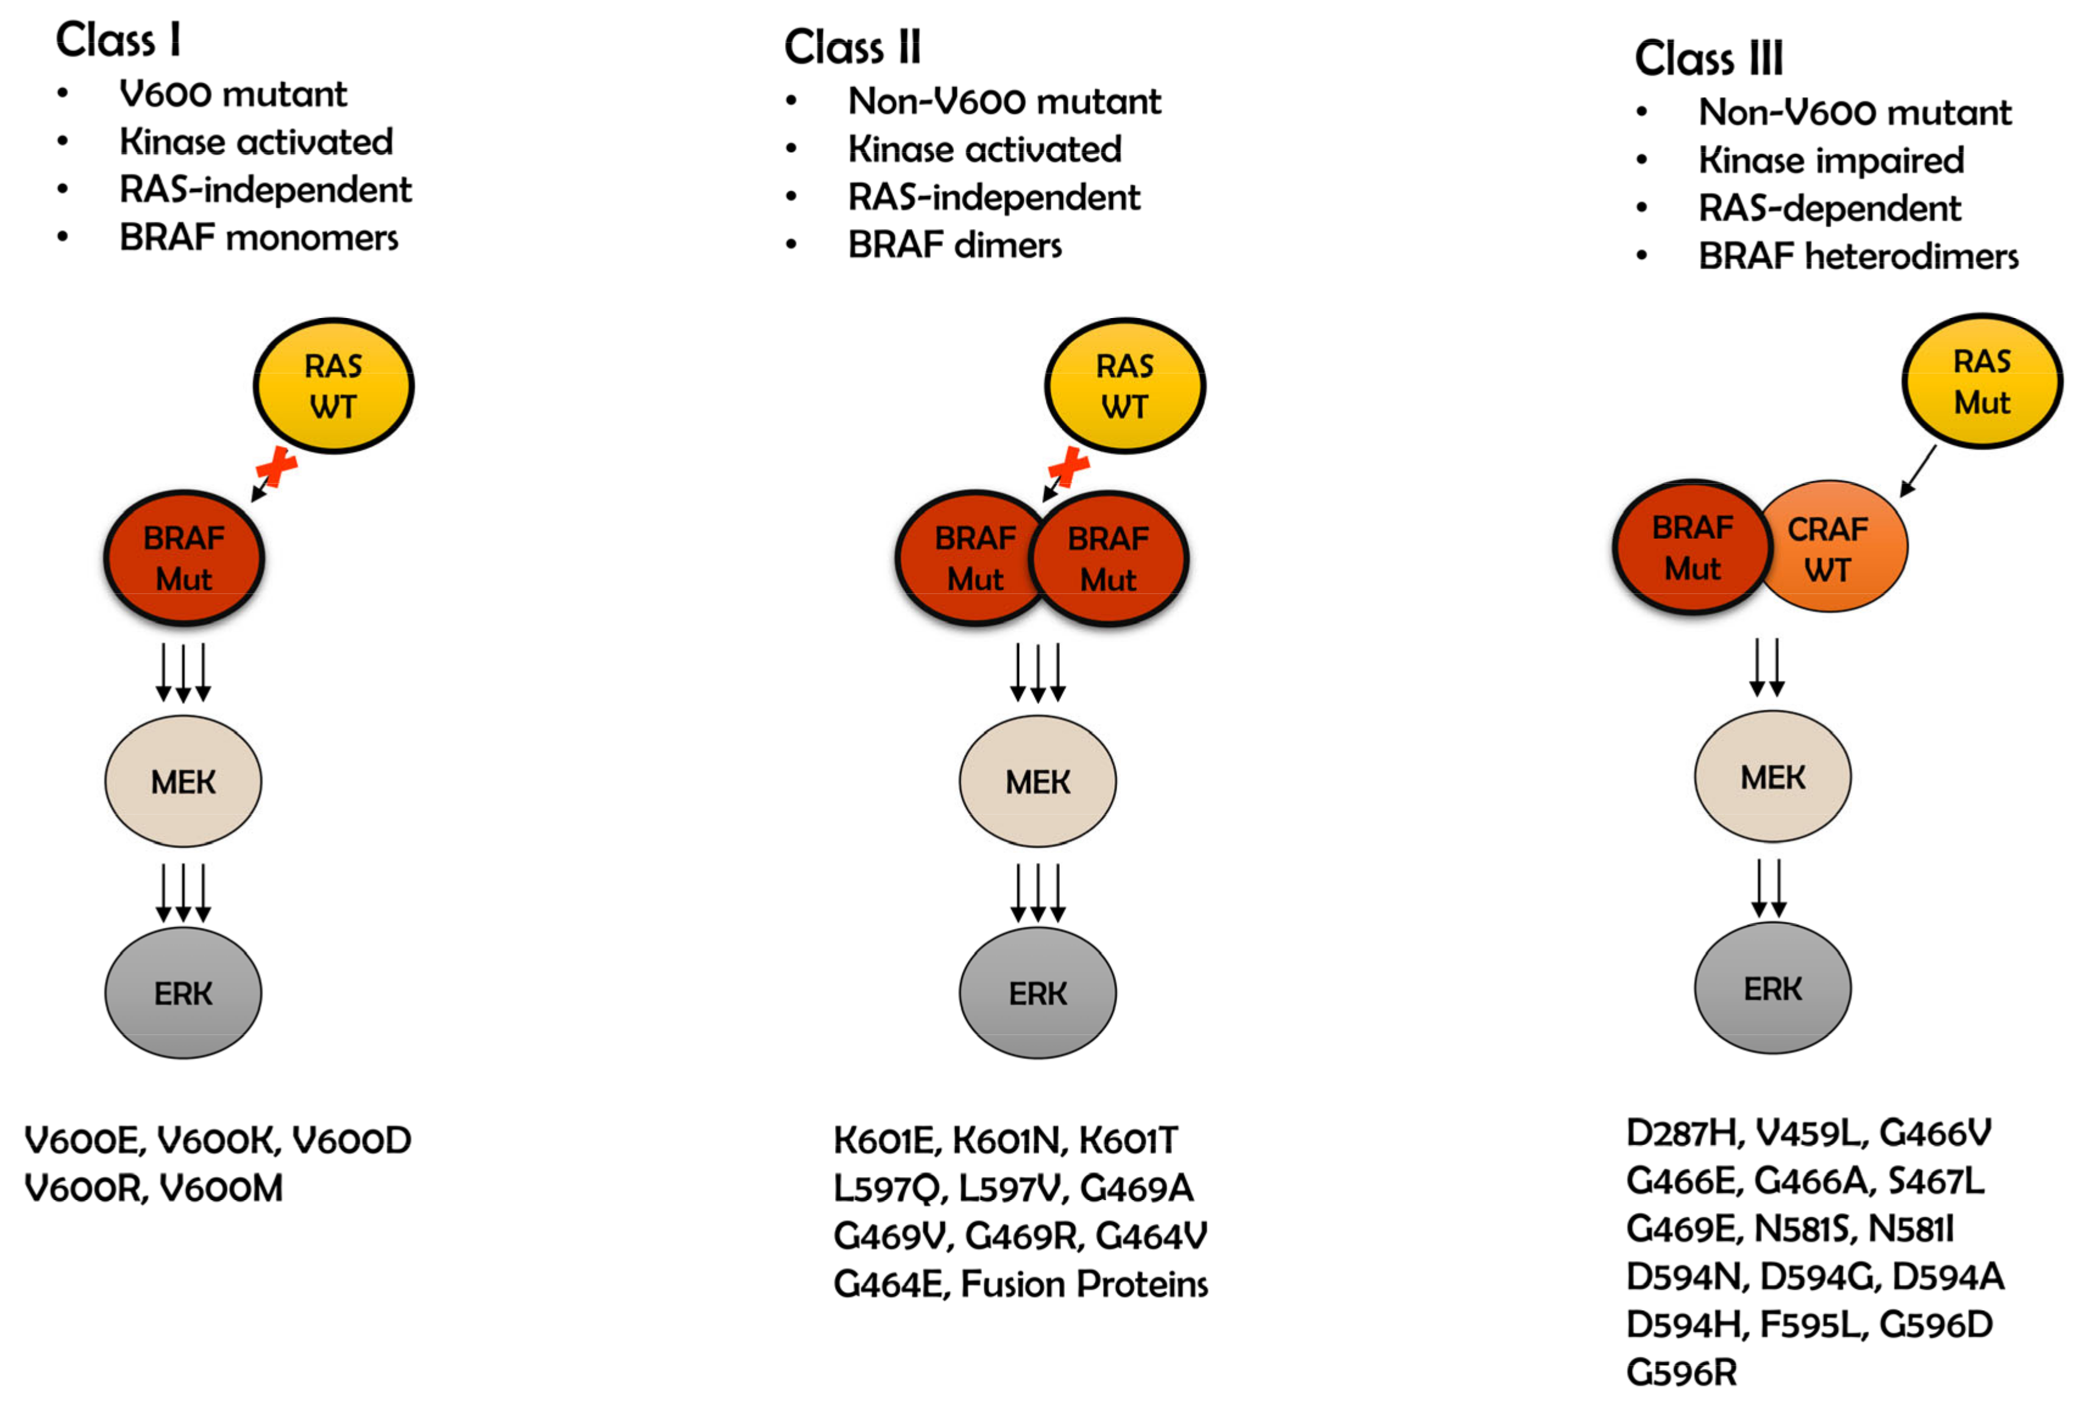
BRAF common mutations
Notes:
Figure 2. The classification of BRAF mutations and their signaling pathways. Class I is related to codon 600. BRAF V600 (BRAF Mut) acts as a monomer in an RAS-independent manner (RAS WT) and constitutively activate extracellular signal-regulated kinases (ERK) by phosphorylation. In class II signal transduction involves non-V600 mutant. Strong kinase activation is regulated by dimers of mutant BRAF (BRAF Mut), independently of RAS (RAS WT). Class III is kinase-impaired and consists of BRAF non-600 mutant (BRAF Mut) and CRAF wild type (CRAF WT) as a heterodimer. The signal is transferred downstream in the presents of RAS mutant (RAS Mut).

Slide 9
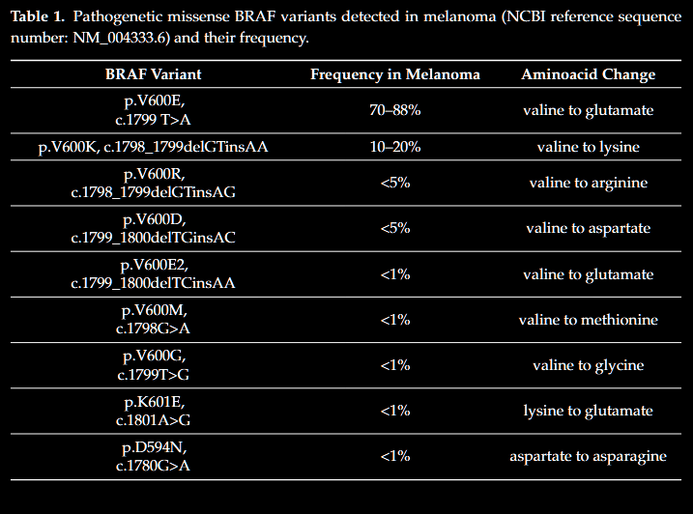
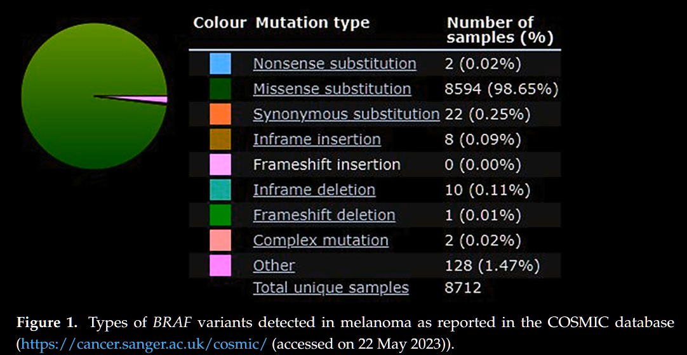
BRAF common mutations
BRAFV600: most common, sensitive to BRAFi (CLASS I)
BRAF V600K is more aggressive than V600E but less common
BRAFL514V: secondary mutation confers resistance to dabrafenib
Mutations involving L597, K601 and G469 increase the BRAF kinase activity but in a different way and are insensitive to BRAFi (CLASS II)
variants involving the D594 and the G596 codons impair the BRAF kinase activity (CLASS III)
BRAF fusions occur 3-6%
P61BRAF(V600E) variant missing exons 4 to 8 that code for the RAS binding domain (alternative splicing)

Slide 10
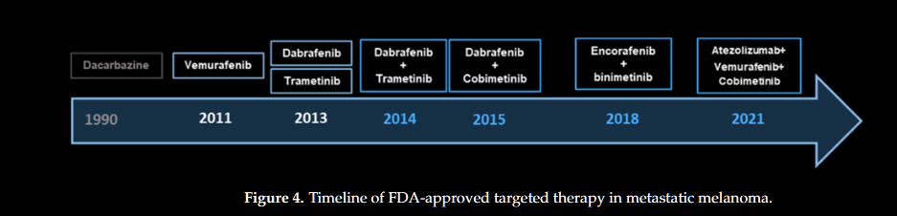
RAF inhibitors: Second generation
vemurafenib: first drug approved in 2011 for BRAF V600E mutations
dabrafenib: approved in 2013 for both V600E and V600K mutations
encorafenib: was approved in 2023 for both V600E and V600K mutations
Others: GDC-0879, LY3009120

Slide 11
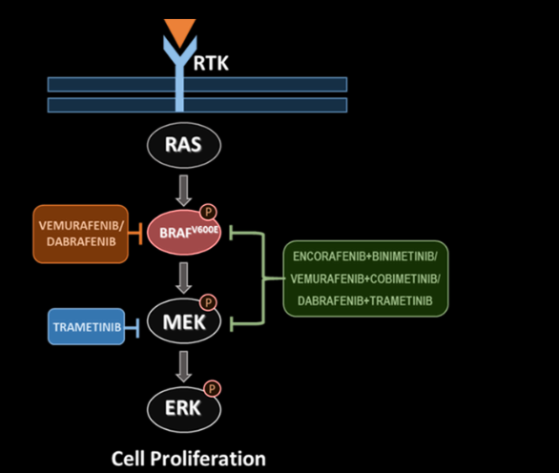
RAF inhibitors: Second generation
Second generation of BRAFi => kinase inhibitors that bind the ATP-binding site of BRAF-mutated protein, leading to their inactivation.
The affinity of BRAF(i) for mutated BRAF induces inhibition of ERK phosphorylation and of cell proliferation Only BRAF-mutant cell lines with an increase in specificity or efficacy

Slide 12
References
[1] D. E. Durrant and D. K. Morrison, “Targeting the Raf kinases in human cancer: the Raf dimer dilemma”, Br J Cancer, Jan. 2018
[2] G. Castellani et al., “BRAF Mutations in Melanoma: Biological Aspects, Therapeutic Implications, and Circulating Biomarkers”, Cancers, Jan. 2023
[3] J. Wang et al., “A secondary mutation in BRAF confers resistance to RAF inhibition in a BRAF V600E-mutant brain tumor”, Cancer Discov, Sep. 2018
[4] T. Xu et al., “Molecular mechanisms underlying the resistance of BRAF V600E-mutant metastatic colorectal cancer to EGFR/BRAF inhibitors”, Ther Adv Med Oncol, 2022

Slide 13
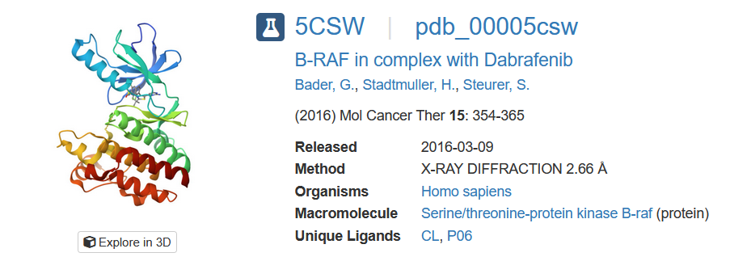
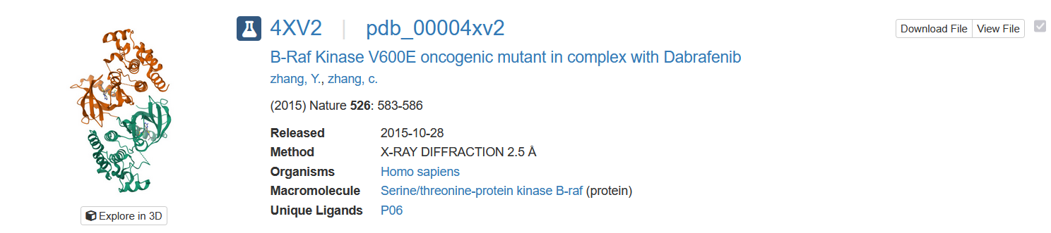
PDB structures: BRAF

Slide 14
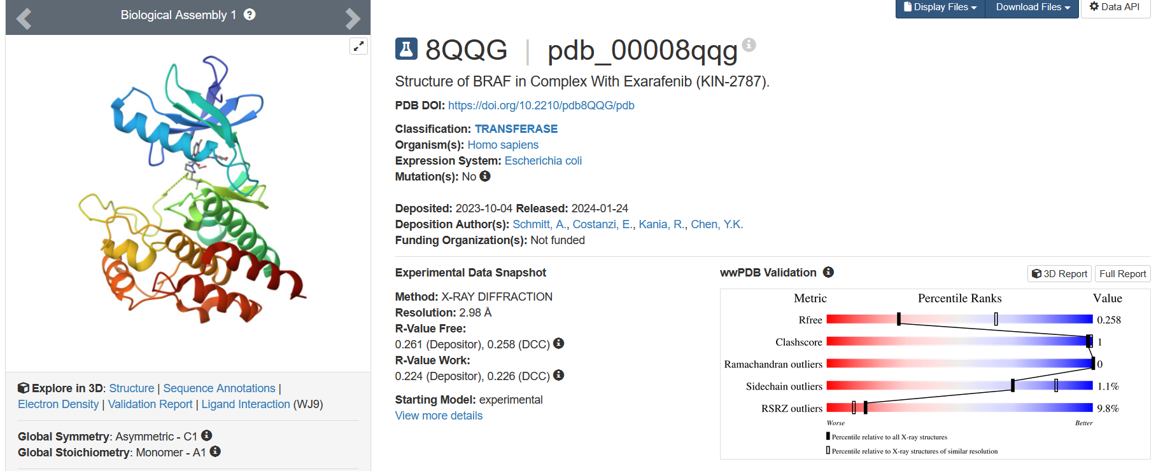
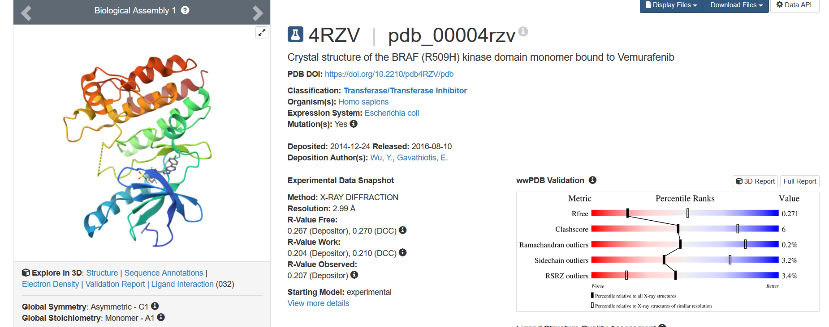
PDB structures: BRAF

Slide 15
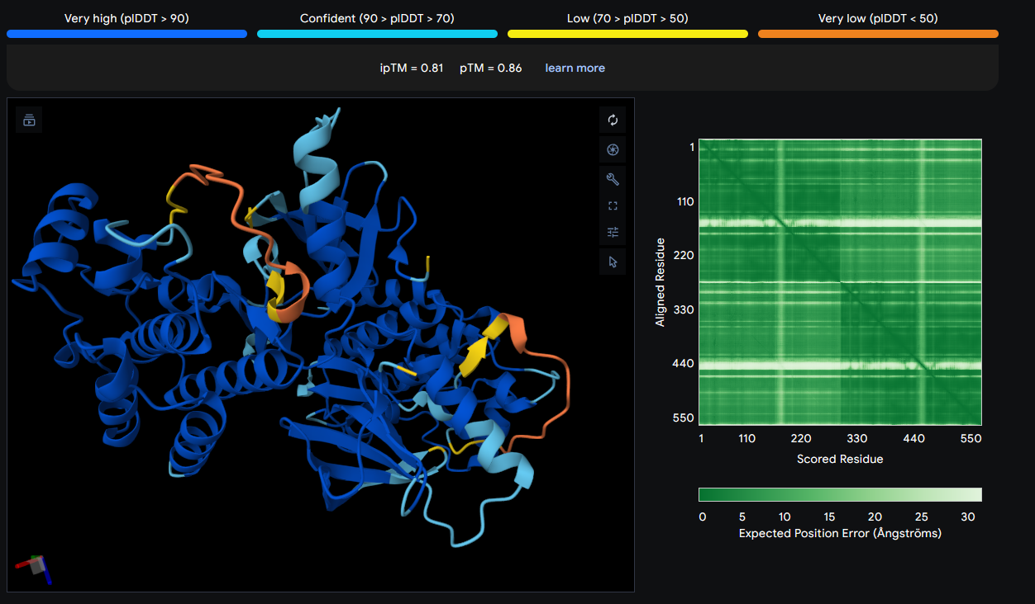
Alpha fold server dimer prediction

Slide 16
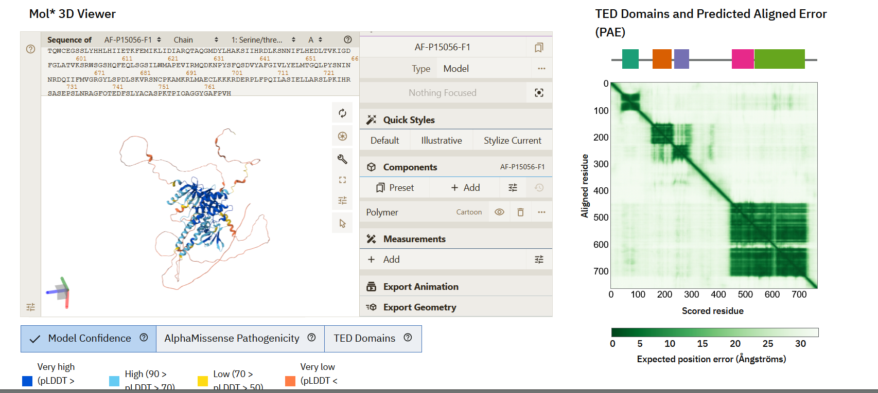
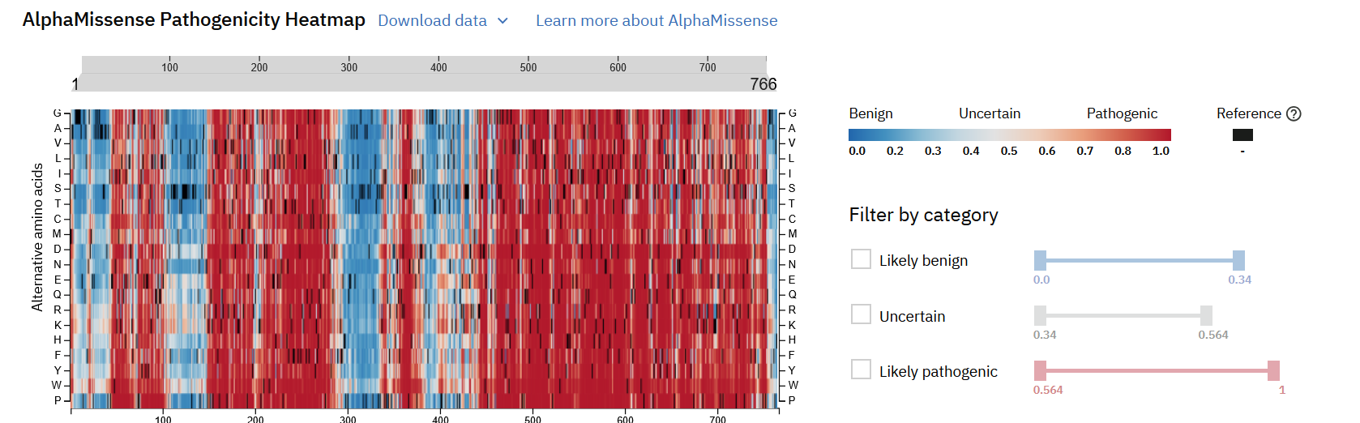
Alpha fold server database

Slide 17
RESULTS
Alpha fold 3 and BeaTMuSiC

Slide 18
BRAF common mutations
Notes:
Figure 2. The classification of BRAF mutations and their signaling pathways. Class I is related to codon 600. BRAF V600 (BRAF Mut) acts as a monomer in an RAS-independent manner (RAS WT) and constitutively activate extracellular signal-regulated kinases (ERK) by phosphorylation. In class II signal transduction involves non-V600 mutant. Strong kinase activation is regulated by dimers of mutant BRAF (BRAF Mut), independently of RAS (RAS WT). Class III is kinase-impaired and consists of BRAF non-600 mutant (BRAF Mut) and CRAF wild type (CRAF WT) as a heterodimer. The signal is transferred downstream in the presents of RAS mutant (RAS Mut).

Slide 19
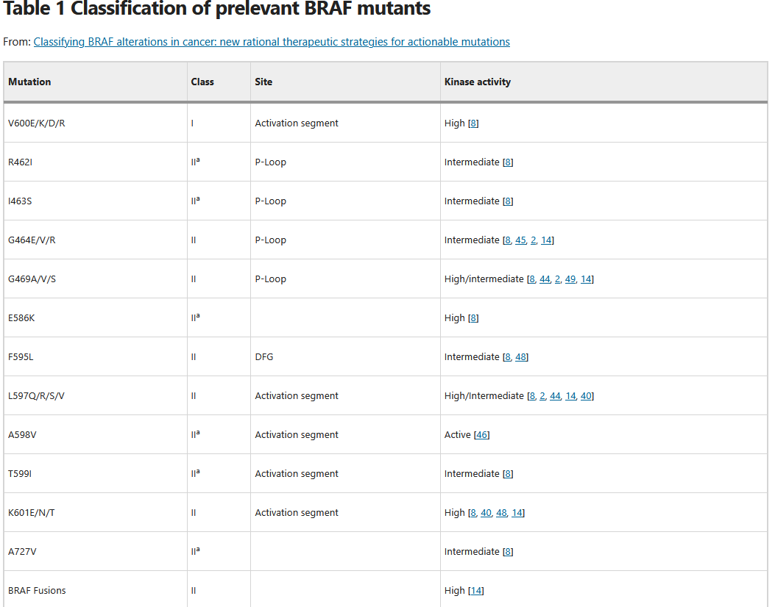
https://www.nature.com/articles/s41388-018-0171-x/tables/1

Slide 20
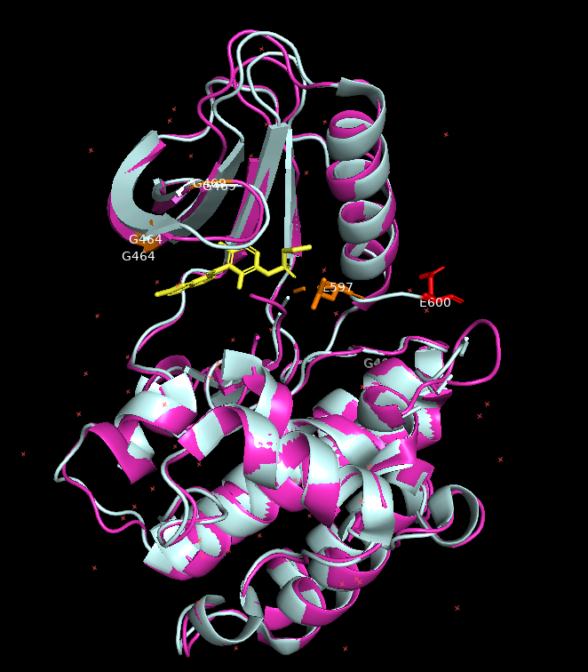
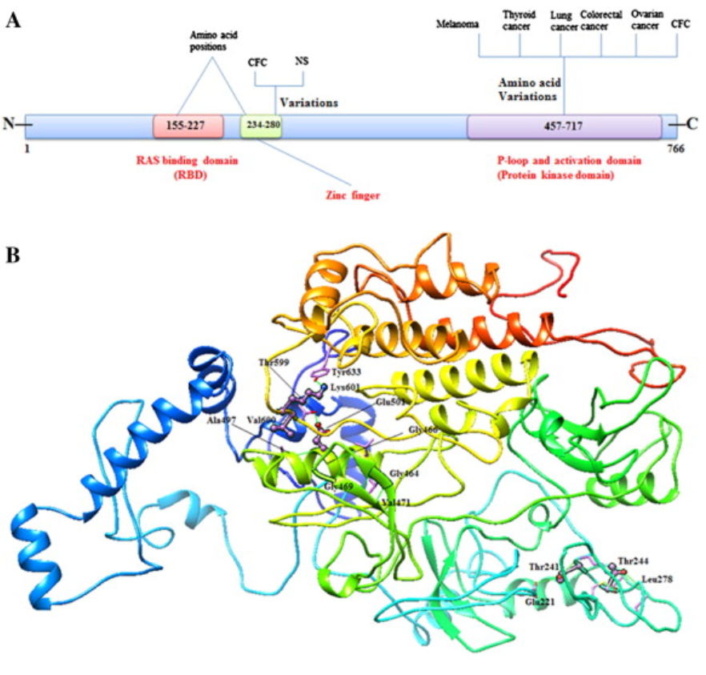
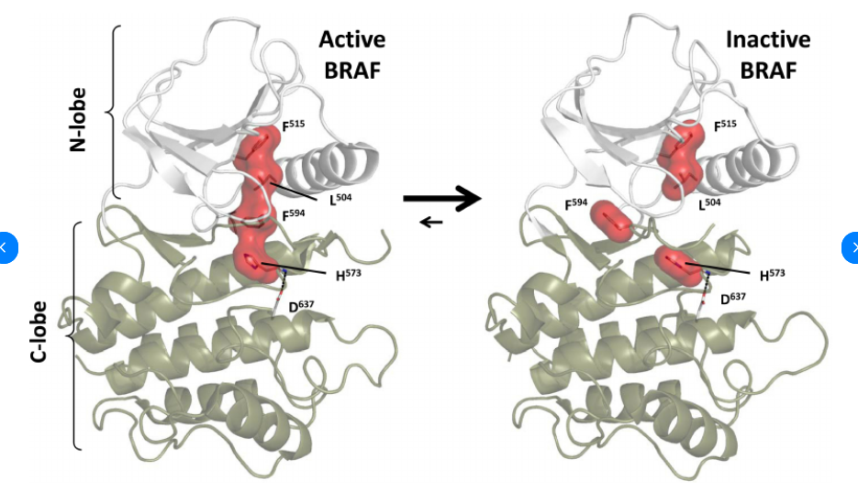
Structural information
Pymol visualization of pdb 3C4C (purple) and 3OG7 (white)
BRAF gene: From human cancers to developmental syndromes - Mukhtiar Baig & al.
Kinases and Pseudokinases: Lessons from RAF - A. Shaw & al.
Notes:
3C4C (wildype)
3og7 (mut V600E)
Yellow = drug
Orange is class 2 mutations
Red is class 1 mutation (V600E)

Slide 21
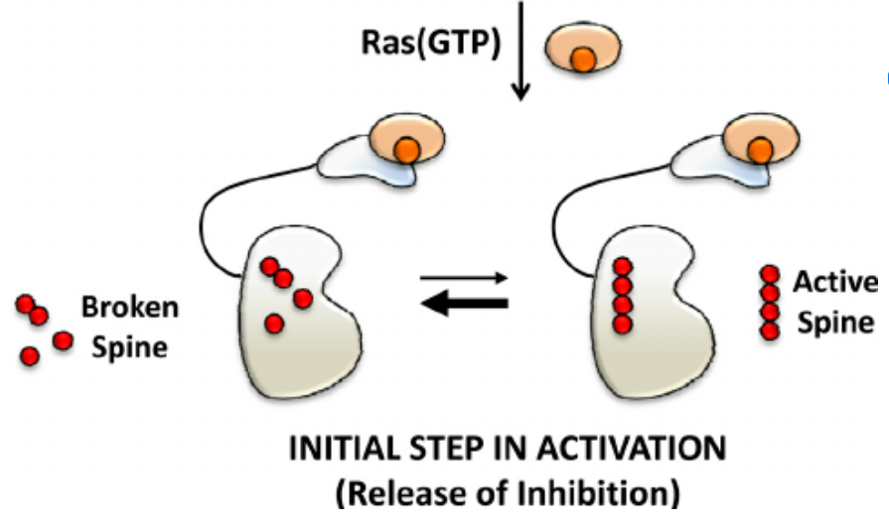
Kinases and Pseudokinases: Lessons from RAF - A. Shaw & al.

Slide 22
Class 2 mutations: BRAF dimer
Mutation | ΔΔGbind – AF3 model | ΔΔGbind – PDB 8PPG | Interface ?
Wildtype
K601E | +0.01 | +0.55
K601N | -0.02 | +0.55
K601T | -0.32 | +0.33
L597S | +0.46 | +0.19
L597Q | +0.14 | +0.10
L597V | -0.19 | -0.25
G469A | +0.54 | +0.78
G469V | +0.60 | +0.82
G469R | +0.71 | +0.78
G469S | +0.80 | +1.11
G464V | -0.09 | -0.67
G464E | +3.99 | -0.17
T599I | -0.04 | -0.21

Slide 23
Class 2 mutations: BRAF_MEK1
Mutation | ΔΔGbind – AF3 model | ΔΔGbind – PDB 6PP9 | ΔΔGbind – PDB 6Q0J
Wildtype
K601E |  | +0.48 | +0.14
K601N |  | +0.25 | +0.08
K601T |  | +0.34 | +0.06
L597S |  | +0.82 | +0.35
L597Q |  | +0.76 | +0.25
L597V |  | +0.85 | +0.32
G469A |  | +0.09 | +0.07
G469V |  | -0.11 | +0.07
G469R |  | +0.29 | +0.2
G469S |  | +0.26 | -0.02
G464V |  | +0.73 | +0.09
G464E |  | +1.27 | +0.11
T599I |  | +0.29 | +0.02

Slide 24
Class 2 mutations: BRAF_14-3-3 (active)
Mutation | ΔΔGbind – AF3 model | ΔΔGbind – PDB 6Q0J
Wildtype
K601E |  | +0.14
K601N |  | +0.08
K601T |  | +0.06
L597S |  | +0.35
L597Q |  | +0.25
L597V |  | +0.32
G469A |  | +0.07
G469V |  | +0.07
G469R |  | +0.2
G469S |  | -0.02
G464V |  | +0.09
G464E |  | +0.11
T599I |  | +0.02

Slide 25
Class 2 mutations: BRAF_CRAF
Mutation | ΔΔGbind – AF3 model | ΔΔGbind – PDB model
Wildtype |  | No pdb model found
K601E
K601N | -0.02
K601T | -0.32
L597S | +0.46
L597Q | +0.14
L597V | -0.19
G469A | +0.54
G469V | +0.60
G469R | +0.71
G469S | +0.80
G464V | -0.09
G464E | +3.99
T599I | -0.04

Slide 26
Limitations/ Remarks
Long unstructured loops in AF3 predictions (pdb shorter sequences)
Common mutations in the literature are not highlighted by this approach (601, 597, …)
BRAF-BRAF and BRAF-CRAF complexes are unstable and require protein 14-3-3 to dimerize properly in active and inactive form
Alpha Fold 3 approximations are too noisy to reliably detect minor binding affinity change in either complexes ?

Slide 27
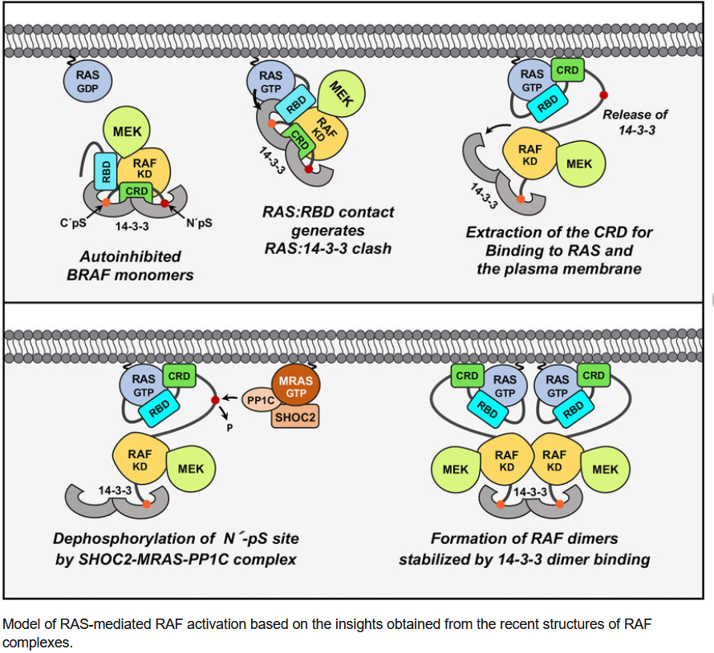

Slide 28
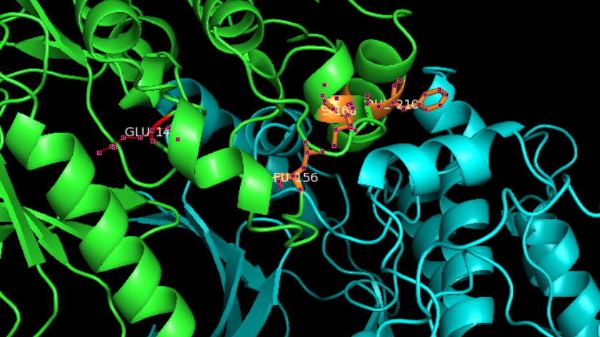
Notes:
Braf in green mek in cyan, orange are interface residues identified by beatmusic, red is V600E mutation

Slide 29
BRAF_MEK ΔΔGbind results
Mutation | ΔΔGbind – AF3 model wildtype | ΔΔGbind – AF3 model mut_V600E
V600E / E600V | +0.90 | +0.03
K601E | 0.02 | -0.04
K601N | 0.04 | 0.07
K601T | -0.11 | -0.07
L597S | 0.51 | 0.51
L597Q | 0.44 | 0.43
L597V | 0.33 | 0.43
G469A | 1.01 | 0.78
G469V | 0.97 | 0.85
G469R | 1.00 | 0.92
G469S | 1.21 | 0.89
G464V | 0.45 | 0.48
G464E | 0.88 | 0.87
T599I | 0.37 | 0.24

Slide 30
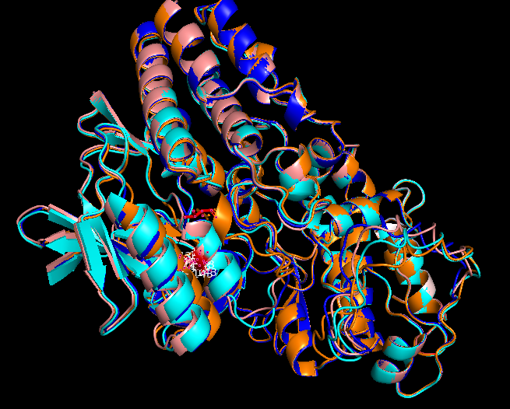
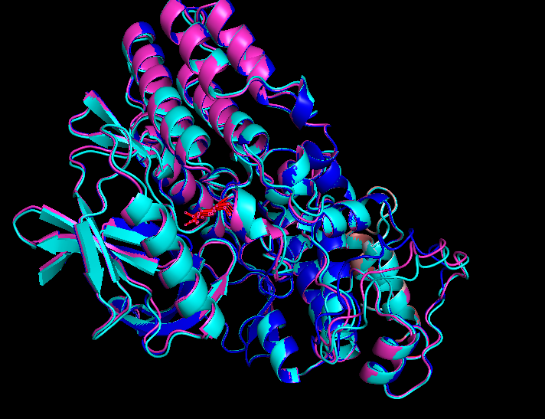
Wild type cluster
Mut_V600E cluster
AF3 predicted conformation cluster. RED residue represents residue 600 in both clusters.
Model 8 in wildtype predictions has structure similar to mut_V600E models predictions. Also model 9 in mut_V600E is verry similar to wildtype cluster

Slide 31
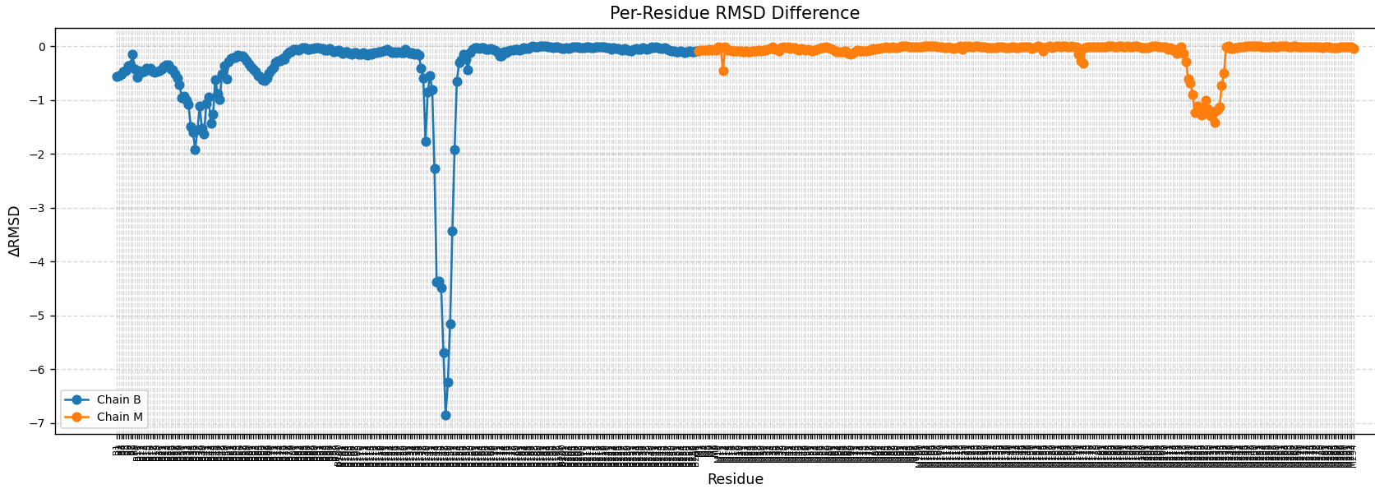
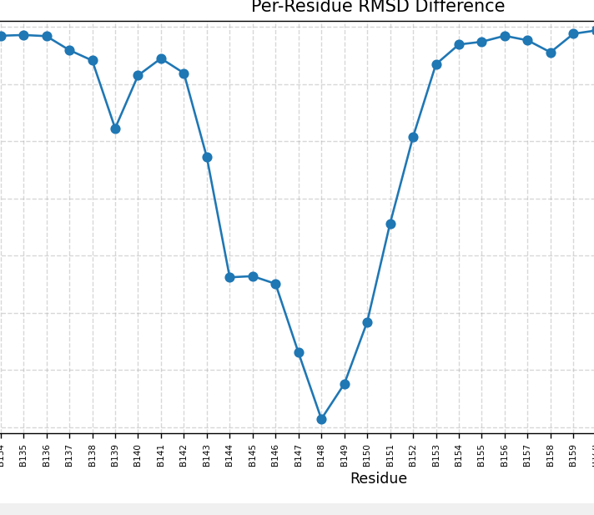
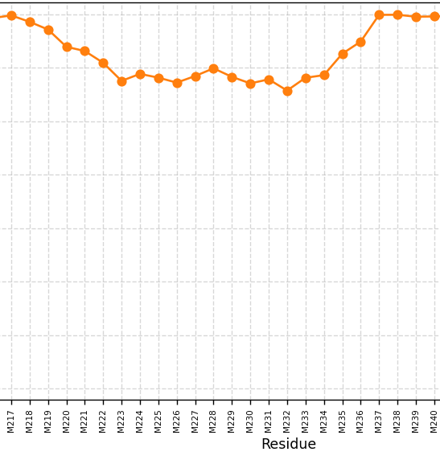
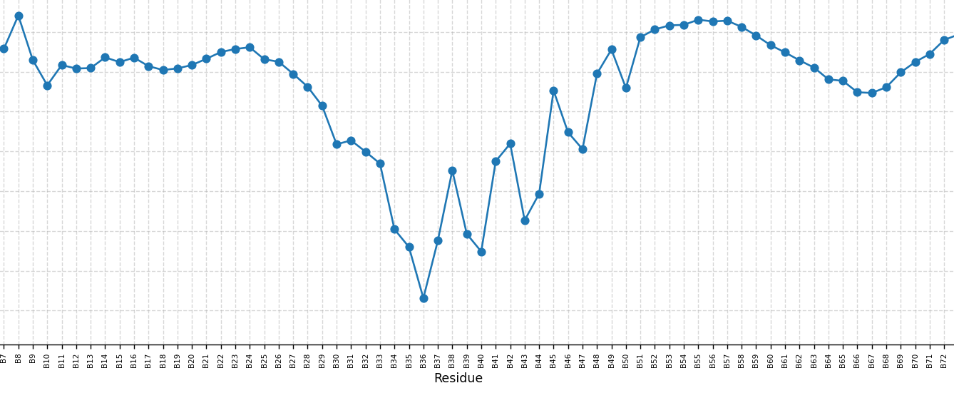
Absolute value of RMSD differences between wt and mut_V600E cluster centroids
V600E
V600E
BRAF: res 464 to 536
MEK: res 283 to 306
BRAF: res 596 to 610
Notes:
464 to 536 are the residues at the interface between mek1 and braf (Protein kinase domain = 457-717) residues 596 to 610 are frequently mutated (class 1 or 2) in cancer
MEK residues 270 to 306 are in the RAF1-binding domain

Slide 32
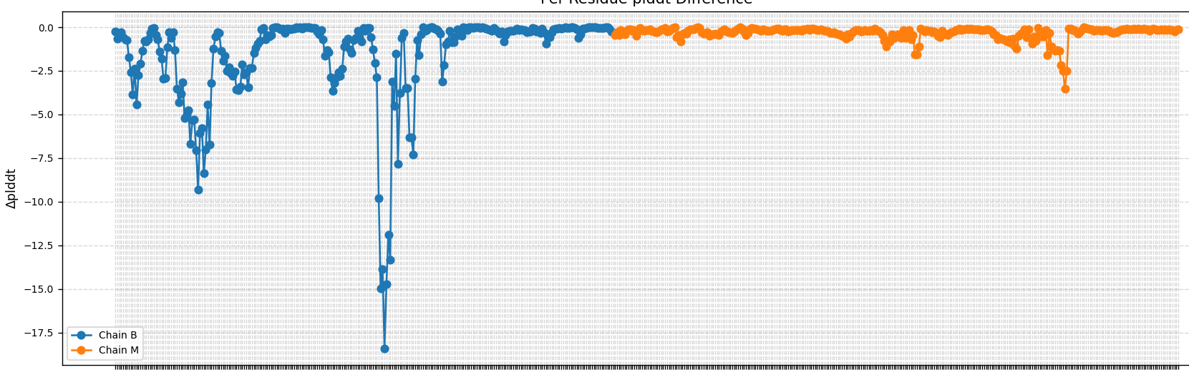
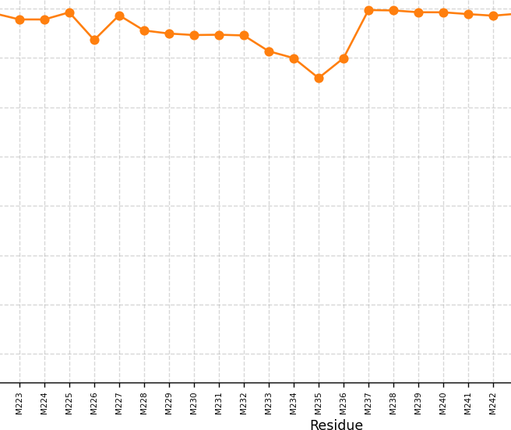
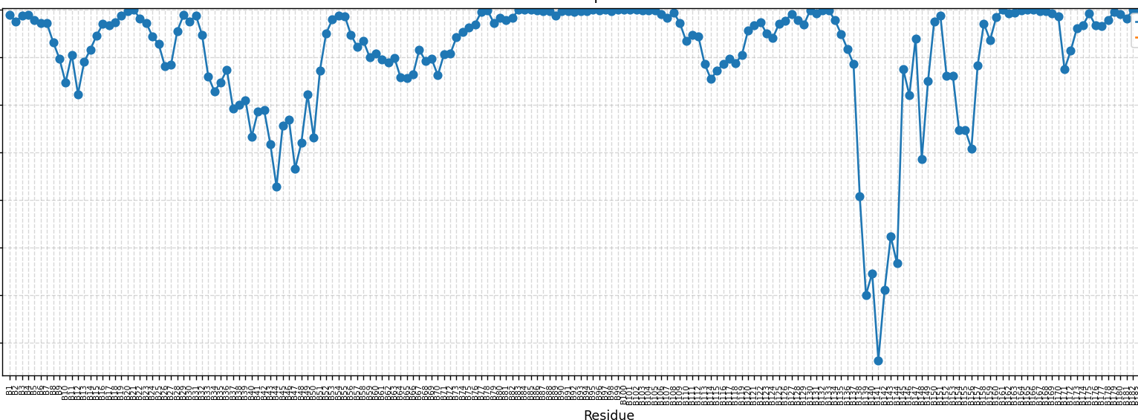
Absolute value of pLDDT differences between wt and mut_V600E cluster centroids
V600E
BRAF: res 566 to 639
BRAF: res 464 to 536
V600E
MEK: res 289 to 403
Notes:
464 to 536 are the residues at the interface between mek1 and braf (Protein kinase domain = 457-717) residues 596 to 610 are frequently mutated (class 1 or 2) in cancer
MEK residues 270 to 306 are in the RAF1-binding domain

Slide 33
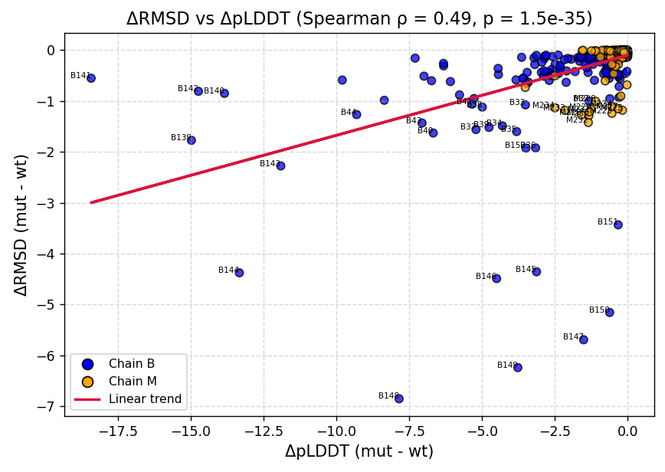
Spearman correlation between RMSE and pLDDT differences between wt and mut_V600E cluster centroids
V600E

Slide 34
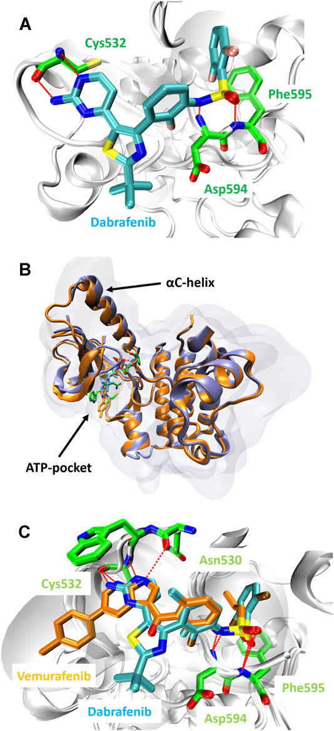
Dabrafenib
Dabrafenib is most effective against the BRAF V600E and V600K mutation
Binds the ATP-binding site of the BRAF monomer, inhibiting its kinase activity and downstream signaling through the MAPK/ERK pathway
Dabrafenib binds BRAF before the formation of the BRAF-MEK complex
“Metastatic Melanoma: Insights Into the Evolution of the Treatments and Future Challenges”, A. Millet & al.

Slide 35
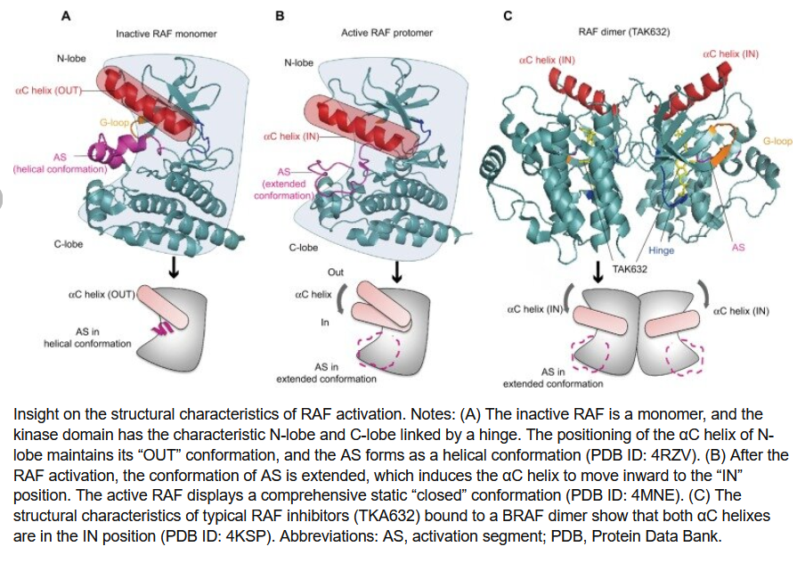
“Development of small-molecule therapeutics and strategies for targeting RAF kinase in BRAF-mutant colorectal cancer”, 2018, Pan Jinghua & al., Cancer Management and Research

Slide 36
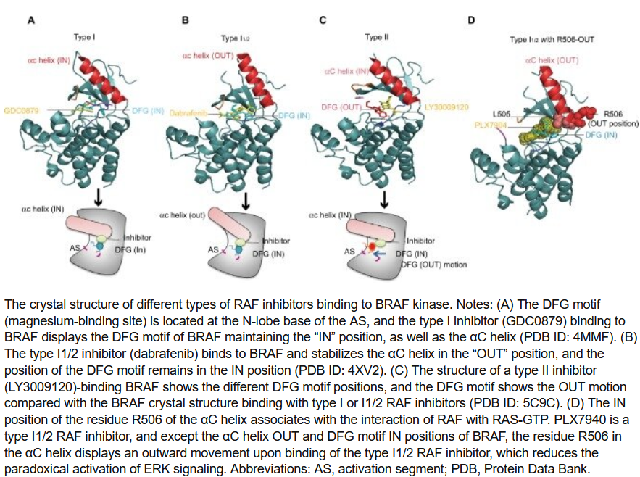
“Development of small-molecule therapeutics and strategies for targeting RAF kinase in BRAF-mutant colorectal cancer”, 2018, Pan Jinghua & al., Cancer Management and Research

Slide 37
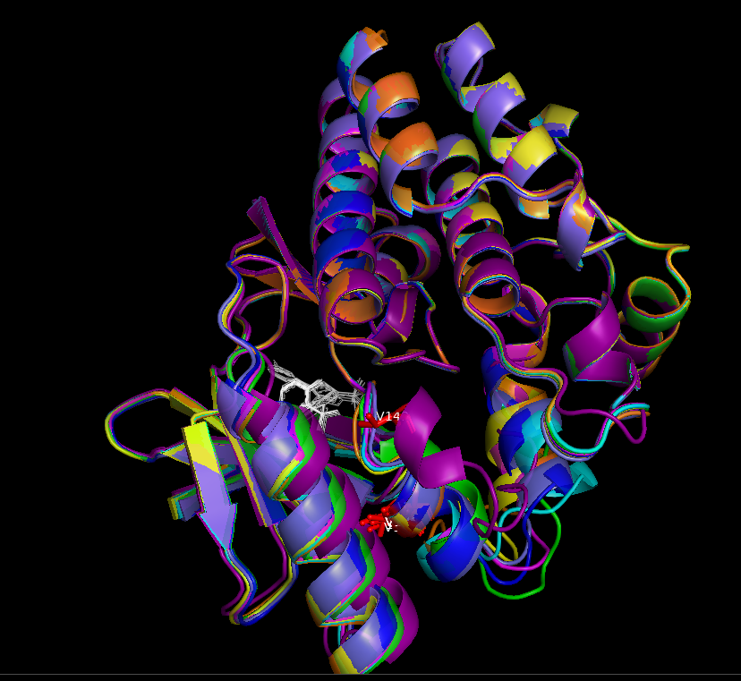
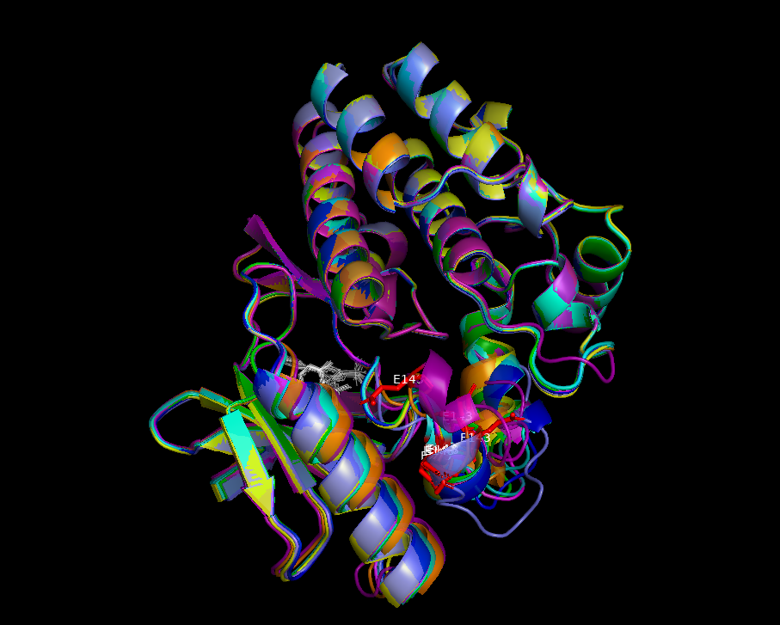
Wild type cluster
Mut_V600E cluster
AF3 predicted conformation cluster. RED residue represents residue 600 in both clusters. WHITE molecule is dabrafenib drug.
Model 8 in wildtype predictions has structure like mut_V600E models predictions. Also model 9 in mut_V600E is very similar to wildtype cluster

Slide 38
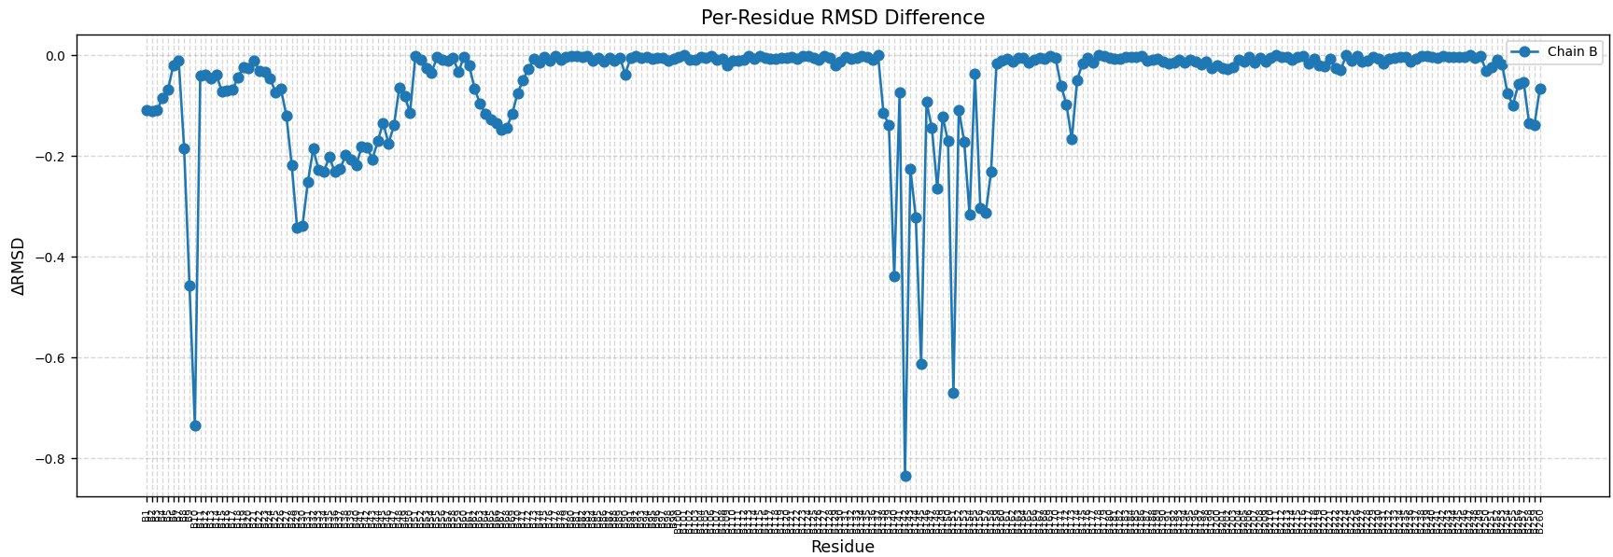
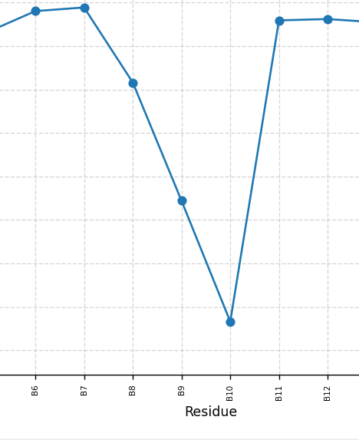
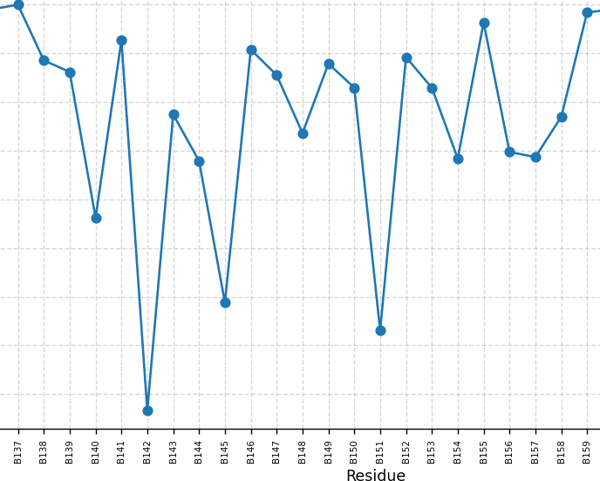
Absolute value of RMSD differences between wt and mut_V600E cluster centroids
V600E
V600E
res 464 to 469
res 595 to 615

Slide 39
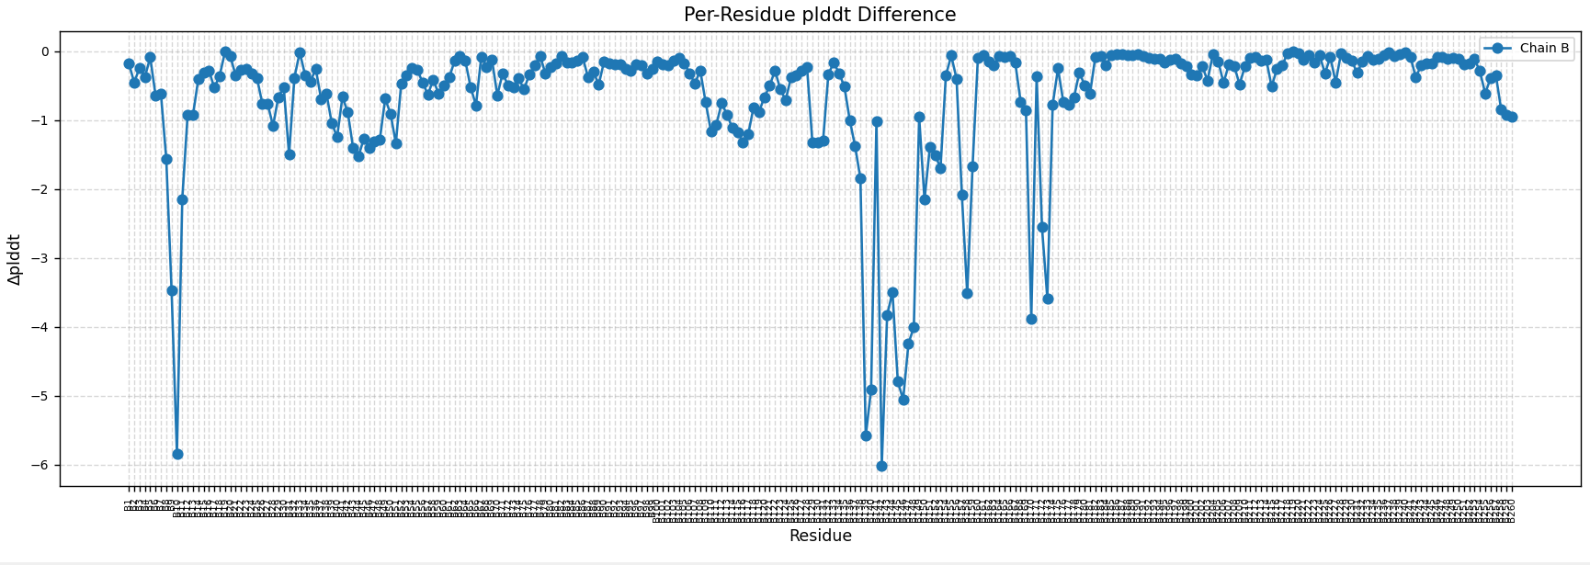
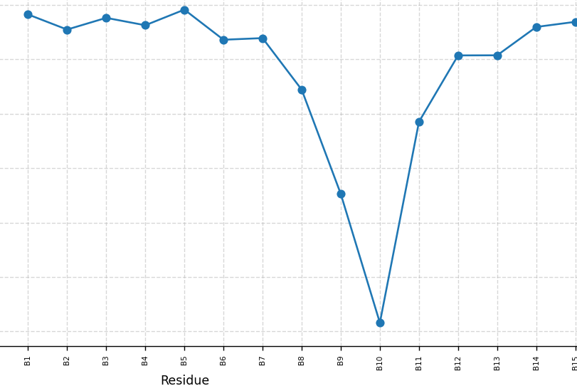
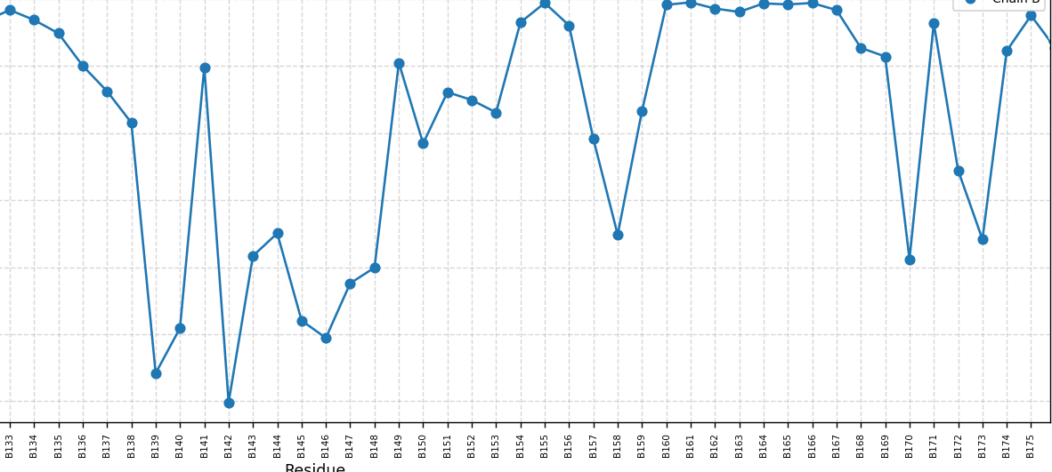
Absolute value of pLDDT differences between wt and mut_V600E cluster centroids
V600E
res 596 to 605
V600E
res 464 to 469
res 615
res 627 to 630

Slide 40
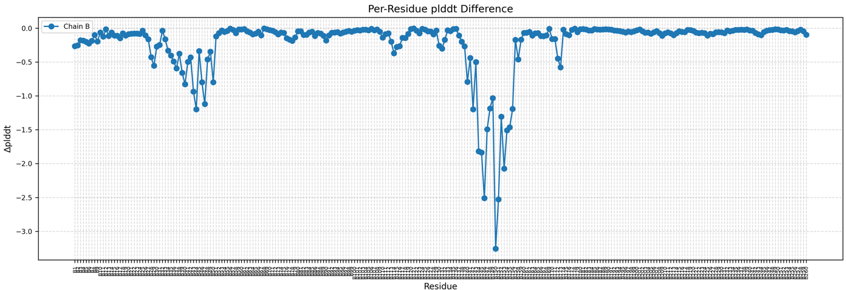
WILDTYPE VS. MUTANT
WILDTYPE VS. CONTROL (WT)

Slide 41
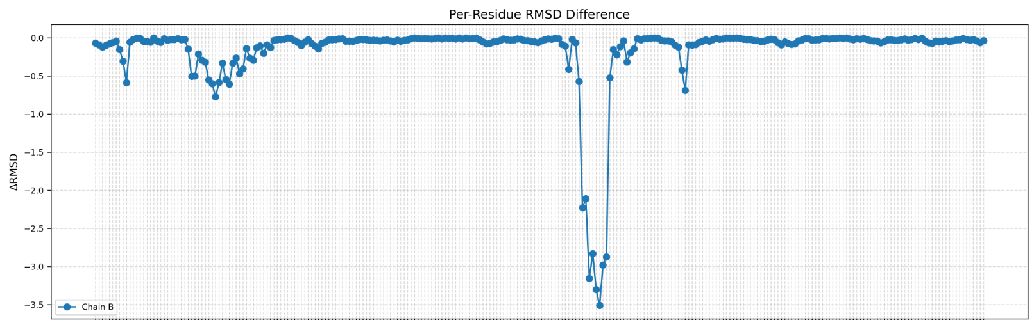
WILDTYPE VS. MUTANT
WILDTYPE VS. CONTROL (WT)

Slide 42
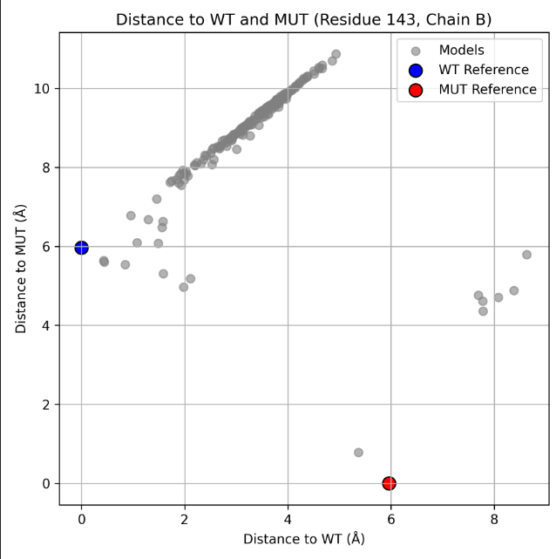
Compare 200 Braf-Dabrafenib models
Notes:
Euclidean distance in 3D space between the Cα atom (alpha carbon) of residue 143 in
each model vs. the aligned reference structures.

Slide 43
Boltz2
Ai driven model for binding affinity predictions
Ki, Kd, IC50, AC50, EC50, XC50 predictions
Affinity data from PubChem, ChEMBL, and BindingDB

Slide 44

Boltz-2: Architecture
Notes:
Trunk : Main calculations, Pairformer, MSA
Denoising + steering: an inference-time method that applies physics-based potentials, which improves physical plausibility without sacrificing accuracy.
Confidence module: predict models own confidence
Affinity module: predicts binding or not/ predicts binding affinity values (Km, Ki, Ic50, ect…)

Slide 45

Boltz2 input: protein-ligand affinity
Yaml file:

